Slide 1
HOUSTON SHOOTING RANGE
Bring Your Firearm Or Rent At Full Armor Gun Range

Slide 2
Meet Brent Hathorn, the owner of the Full Armor Gun Range in West Houston, Texas, right off the I-10 freeway, as we talk to him specifically about the shooting range!

Slide 3
How long has the shooting range been a part of Full Armor?
Seven years.

Slide 4
How did you first get involved or what was your vision for starting a shooting range?
James originally invested in the store. We had a mini gun range, but we needed more stable space. So, when the space became available, we realized that we could use it for our shooting range area expansion.

Slide 5
What was your experience growing up with guns? Did you shoot them outdoors or in an indoor range?
I grew up out in deer hunting school. I started shooting when I was very young, probably about five years old or so. We lived in a pretty outdoor situation, and we shot guns out the back door, at trees, since we were basically in the country.
I see. Did you shoot at other ranges in the Houston area as you got older?
No, not really. I had never really shot at a range growing up. My parents had a ranch with a lot of outdoor space. With all that property there wasn’t really a need to go anywhere else. But you recognize the challenge for city dwellers who may not have access to country property. They need a place to shoot. Oh yeah, totally. Plus, you eliminate a lot of factors with an indoor range, like situation deterioration. The weather is a factor in outdoor ranges. Safety can also be an issue because there aren’t barriers. Can you tell us about the safety factors and differences? In our indoor range, when someone is shooting beside you, they can’t inflict any harm to you at all. Each lane is completely isolated from the others at Full Armor indoor range. Outdoor ranges often just have a wooden shelf or something in between each lane. That’s not going to stop a firearm. We have two layers of glass. Someone could put a gun down, and it can go off. In those cases, you want to have that safety divider or else you have to hope the gun was pointed straight and not cockeyed. Some places will make the lanes very narrow to fit more people in their range to get more business. We decided to only do ten to keep the lanes wider and safer. That’s fascinating. Thank you for explaining the building material choices that your partnership made. It’s nice that you were willing to incur additional construction costs to design the range for maximum safety and so that small groups could be together in a comfortable setting.

Slide 6
Was there room for a sitting area or any chairs inside?
Yes, we do have some benches so that observers can sit down. Let's talk a little bit about going to the shooting range for somebody who's new to a shooting indoors.

Slide 7
What is the protocol for an indoor shooting range?
Our gun range does have certain rules! You always need to be aware when you reload the weapon or put the gun down. The gun needs to be pointed away from any others, etc. Sometimes in groups, people may want to walk around and talk to one another or pose with the gun, and that’s just not safe to move around with a weapon, so we sometimes have to go in there to talk to them. It’s just very important to point the guns in the proper direction. Also, choose certain clothes. Some people may wear gloves in there. Women shouldn’t wear low-cut shirts. The hot brass can burn men and women in the chest area when it gets ejected from the gun. Those are some things to avoid.

Slide 8
What about noise or talking?
We require everyone to wear eye and ear protection while they are in the range. We offer high quality options for this, so of course when people talk to each other, it needs to be louder since everyone is wearing ear protection in the range. Are there lockers or any kind of storage element available in the range? Yes, we do have storage in the range. People can leave their items with the supervision of the range attendant. You can leave your purse or phone or any personal items if you don’t want to bring it in with you.

Slide 9
What does someone need to bring to the range?
We need to see identification for every person who uses the range. So they would need to bring an ID or passport with them. You have to be 21 to use a handgun in the state, so we need to verify age. We do allow people to bring their own guns and ammo, so if you wanted to use your own gun, you would need to bring that. However, we also offer gun rental here in our store. So, you can rent a gun and buy ammo to use while you’re in the range. Though all of that still has to be monitored, so you would need an ID. We just put your ID in the spot where the gun is normally stored. That way, if someone walks out with the gun (which is a federal offense), we know who it was. Believe it or not, it does happen when people forget to return them. I have had to run down the sidewalk after them before.

Slide 10
Can a person trade out their rented gun during the session?
Yes, they can trade it out if they want to try other guns. In a way, this allows customers to try out a gun before they buy it as well. We just replace the original gun and put their ID where the one they wanted to try next belongs. We also have full auto Friday, where you can pay 100 bucks and try out any fully automatic you want. We have a few different trial programs like that.

Slide 11
What weapons can people choose from? Are they able to shoot or rent any gun that’s displayed at the store?
Not in the store. We actually have a lot of guns that we sell in this store that we rent in the gun range. It’s one of the things that helps us to stand out from other stores. People often want to know how a gun feels in their hand or shoots before they purchase it. What we do here is if you rent a gun from us and you purchase it, we’ll actually take the price of the gun rental off of the purchase price. We carry all the way from 22 to 500 Smith and Wesson, which is about the shell size of most. We have about everything: fully automatics, revolvers, etc. We also carry accessories like the suppressors, which lowers the sound and kickback.

Slide 12
Are there any weapons or ammo that aren’t allowed in the range?
Yes, we don’t allow shotguns. They throw out the plastic casings, so we just eliminate that. We only do brass or brass casings. No steel, no armor-piercing. It should be common sense, but not everyone knows.

Slide 13
Are there any coupon discounts for other times of the week? I know you mentioned Full Armor Friday.
Yes, we have a ladies’ night for a discount in the range. Ladies’ night is on Monday. We also have military discounts. Police officers often come in to shoot, and we provide a discount for them as well. There is also a shooting club on Tuesdays. Wednesdays is police training, and Thursdays is date night for couples, so you can come in together and only pay the price of one. Friday, as we mentioned before, is full auto Friday. Also, each day we pick out a gun of the day that is 50% off the rental for that gun.

Slide 14
Someone can bring their own weapon?
Oh yeah. You can bring any weapons as you want. We don't charge any additional price for more weapons. I mean, a lot of ranges actually charge you for each additional gun. You can bring in 20 different guns if you want; we don’t charge more for it.

Slide 15
Can someone have a private lesson at the range?
I'm glad you mentioned that. We're one of the few ranges, actually the only range I know that does not charge to have someone teach you how to shoot. We may miss a lot of revenue from that, but it also brings in new customers. Plus, it’s a safety thing. If someone comes in who has never shot before, we have people here who know how to teach a new person to shoot. They teach them how to load the gun, gun safety, etc. We also have professional shooters that come in, you can get private advanced lessons in shooting as well. But as far as basic gun use and safety, we will teach someone for free.

Slide 16
Who works at the range in addition to the marshals? Are the marshals there at all times or during certain hours?
No, but we always have a cashier and backup in the store. If something were to ever happen, we have a lot of people watching to prevent a situation.

Slide 17
Does Full Armor offer range memberships?
Yes, we do offer range membership. It costs $699 for the year. You can come in and pay it all at once, or we will break it down over a 12-month program for you as well, to charge your card each month. Though there is an extra cost for that.

Slide 18
So monthly or annual memberships are available?
These are annual membership, which we can charge you per month (with a slight add on) or you could pay 700 dollars upfront.

Slide 19
And it includes unlimited range access?
Yes, the membership includes unlimited range access. You also get a discount on ammo, 5% off. You get two targets per visit, and you can bring in a guest with you as well. We also have a platinum membership for $850 per year, which includes a free rental up to $20 and 5% off ammunition. We also have a dining membership. That’s really more for big families or companies, that’s $4,000 a year. But all gun rentals are included and up to six guests can shoot for free. You get two lanes with two targets per person, concierge service, 10% off the ammo, and a personal instructor in those memberships. There is no waiting either. If you come in on a Saturday, and there’s a 30-minute wait, you will instantly be put in the front of the line.

Slide 20
It sounds like Saturday mornings are when the range is most active.
Saturday at lunch time is probably the busiest.

Slide 21
Are there any times when someone could come and have a very quiet or private experience? Someone maybe who was nervous or brand new to shooting, what would be a good time to call when there's hardly anyone else around?
Probably mid-afternoons from two to four on weekdays, Monday through Thursday, would be best for that.

Slide 22
Are there any events or times designed for senior adults?
We don't have anything with senior adults specifically. But we love our seniors. We have a lot of them come here all the time. And plan to include more activities specifically for seniors in the future.

Slide 23
What about youth events?
We don’t have any youth events at this time. Really, there are age requirements for that sort of thing. Sometimes we do have younger adults who come in with their guardian to learn about shooting. We may let them share a lane with their dad or whoever they come in with. If they’re below the age, it’s okay because they’re little superstar young men. And then there are some people like no way, they aren’t even close to the age requirement. But it is up to us to decide.

Slide 24
How old does someone have to be to shoot at the range?
Usually 10.

Slide 25
And do any shooting clubs meet at Full Armor?
We have the shooting meeting on Tuesday night and the Houston police come and shoot on Wednesday nights here. Are there any food or beverages available in the range or the store or nearby? Two restaurants share our same parking lot. We have a Vietnamese place called Pho 9 and then we also have a Chinese place called Shanghai that, you know, you can hit it with the baseball next to us. And we have vending machines in our location.

Slide 26
Do people ever bring their food in & eat at the range?
Eating or drinking is not permissible inside the range. Because there’s lead powder, you don’t want to be eating and drinking inside of a silo. We have some of the best circulation for an indoor range, but it’s still not recommended.

Slide 27
Is there a sitting area outside the range where people could eat?
Yes, there is a seating area with a couple of chairs. People also walk around the store as well. If you have a large party, you can call ahead, and we reserve our party room for a minimum of $250.

Slide 28
How do group events work?
Just call us up and let us know when you can come, and we can see if it’s available or not. We have different people who rent the party room for LTC classes or for other parties, so just call us to reserve it.

Slide 29
What's a ballpark for a corporate event using all 10 lanes on a weeknight?
At Full Armor Gun Range can accommodate about 40 people total: four people per range lane. But small company events of up to maybe 20 people could easily be accommodated.

Slide 30
What about events like bachelor or bachelorette parties or a birthday?
Any kind of party like that we can do. We can accommodate you. No problem whatsoever. You know, we can have food. We can order from a restaurant or you can have cake in the party room or whatever.

Slide 31
Does Full Armor offer any archery or ax or knife throwing?
No, we don't. We don't have that to offer. There is an archery facility that’s just down the road, but we don’t offer that. We do sell different knives and axes, but we don’t have a range or training for it. Are there any competitions or leader boards that the range that people can participate in? We do have some little events that we do. Usually, just how accurate someone can be at shooting. We haven’t done one in a while, but we do it from time to time. No, that’s okay. I know you favor indoor shooting for various reasons, as we discussed. Safety in particular. I mean if you have your own track of land, I understand. But these outdoor ones that I’ve been to, I just don’t care for them personally, so I don’t want to recommend them.

Slide 32
How many range sessions would you say it would take a beginner to become proficient with a handgun?
That’s a good question. It just depends on how accurate someone is, you know what I mean? Some people are just naturally accurate. I mean, some people can pick up a basketball and just shoot it in there. It just depends. Some people just pick up things quick, so that’s a hard question to answer. I guess it also depends on what other skills you have. I would say that they could pick it up in a time or two. Also, most people shooting for self-defense don’t have to be accurate that far. Most situations are within two to ten yards. They’re not very far away, so you don’t have to be accurate from a distance. Even most police officers aren’t as accurate as you might think from a distance, because they don’t practice enough.

Slide 33
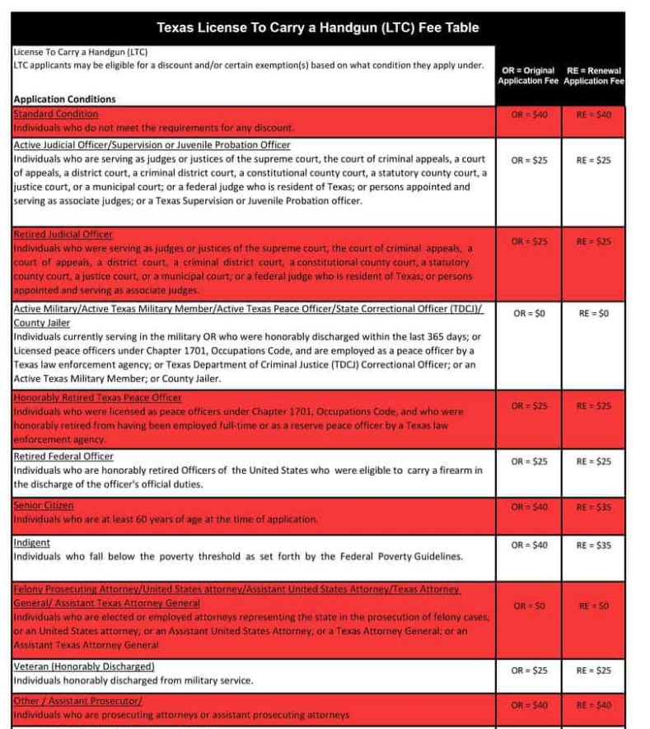

Slide 34
What else should our listeners know about the Full Armor gun range?
People like us because we are open to everyone. Some other places seem more like a country club, and not everyone likes that. We take everybody. We get a large variety of people in here, and we like them. We get people from countries all over the world. People feel comfortable coming here because of how open we are, and if you don’t know how to shoot, we will teach you. We also speak Spanish here as well. We can actually teach shooting in Spanish. We have over $1 million worth of guns to sell and over a hundred guns to rent. So there is a serious variety. I'm glad to know that everyone will feel welcome at Full Armor. And I'm sad to know that, that some ranges in gun facilities are highfalutin, but we shouldn't be surprised. Well, thank you so much for giving us all this information about shooting at the gun range and how it works and particulars and backstory on the range and general shooting and pricing information and events. This will provide a real thorough overview for someone who's looking for their new home range in the West Houston area, for sure.

Slide 35
Contact Us
832.486.9086
11911 Katy Freeway Houston, TX 77079
info@fullarmorgunrange.com
Hours of Operation
MONDAY - FRIDAY
10:00AM - 8:00PM
SATURDAY
9:00AM - 8:00PM
SUNDAY
12:00PM - 7:00PM

Slide 36
HOUSTON SHOOTING RANGE
Thank you…

